Slide 1
Enhancing Performance Of Operating System Using Machine Learning
Project Members:
1. Lakshay Bansal (287/CO/12)
2. Ravish Mahur (339/CO/12)
3. Rishab Banerjee (340/CO/12)

Slide 2
ABSTRACT

Slide 3
Work Hitherto
Courses Done
Machine Learning (Dr. Andrew Ng, Stanford University)
Introduction To Data Science (Dr. Bill Howe, Washington University)
Artificial Intelligence(UC Berkeley)
R Programming (Dr. Roger Peng, John Hopkins )
Introduction To Linux (edX)
Research Papers
Self Learning Disk Scheduling (IEEE)
Applying Machine Learning Techniques to improve Linux Process Scheduling (IEEE)
To Collect Or Not to Collect? Machine Learning For Memory Management ()
Dynamic Multicore Resource Management: A Machine Learning Approach

Slide 4
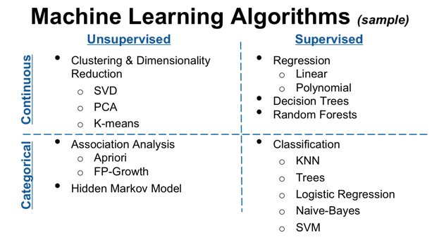
Machine Learning Techniques

Slide 5
Regression
Linear
Logical

Slide 6
Neural Networks

Slide 7
CLUSTERING
Support Vector Machines
K-Means

Slide 8
FOCUS AREAS
Optimize the performance of the following aspects of OS:
Process Scheduling
Memory Management
Disk Scheduling
Cache

Slide 9
PROCESS SCHEDULING

Slide 10
MEMORY MANAGEMENT

Slide 11
DISK SCHEDULING

Slide 12
Adaptive Replacement Cache
Algorithm

Slide 13
Study Material/ Previous Establishments
1). Applying Machine Learning Techniques to improve Linux Process Scheduling
-Atul Negi, Senior Member, IEEE, Kishore Kumar P.

